Slide 1


G2M-insight-for-Cab-Investment-firm
Arron H

Slide 2


Introduction
XYZ is a private firm in US. Due to remarkable growth in the Cab Industry in last few years and multiple key players in the market, it is planning for an investment in Cab industry and as per their Go-to-Market(G2M) strategy they want to understand the market before taking final decision. Project delivery: You have been provided with multiple data sets that contains information on 2 cab companies. Each file (data set) provided represents different aspects of the customer profile. XYZ is interested in using your actionable insights to help them identify the right company to make their investment. The outcome of your delivery will be a presentation to XYZ’s Executive team. This presentation will be judged based on the visuals provided, the quality of your analysis and the value of your recommendations and insights. Data Set: You have been provided 4 individual data sets. Time period of data is from 31/01/2016 to 31/12/2018. Below are the list of datasets which are provided for the analysis: Cab_Data.csv – this file includes details of transaction for 2 cab companies Customer_ID.csv – this is a mapping table that contains a unique identifier which links the customer’s demographic details Transaction_ID.csv – this is a mapping table that contains transaction to customer mapping and payment mode City.csv – this file contains list of US cities, their population and number of cab users

Slide 3
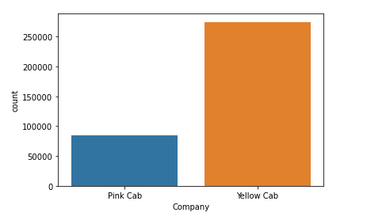
Cab Case Study
Yellow cabs are more popular than pink cabs.

Slide 4
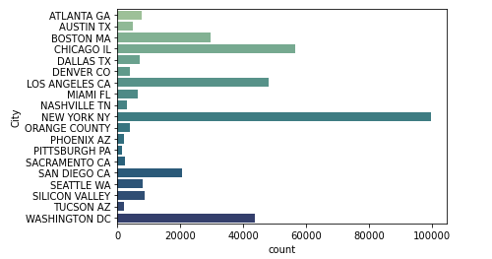
What city has the most trips?

Slide 5
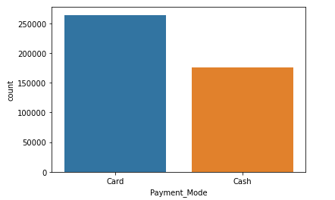
What payment method is preferred?

Slide 6
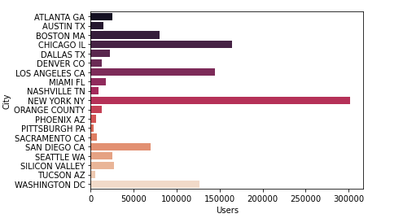
Number of users for each city?

Slide 7
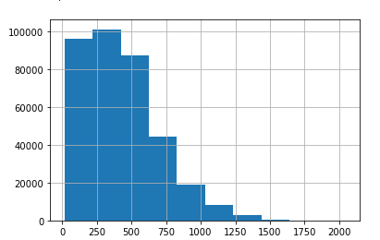
This is a histogram of the pricing for cab rides from lowest to highest. Here we can see that popular cab rides are priced between 250 and 500.

Slide 8
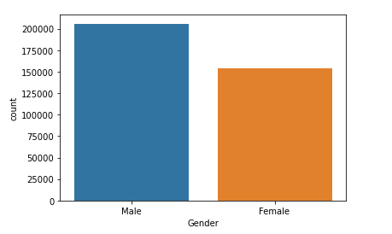
What gender is more likely to use cabs?

Slide 9
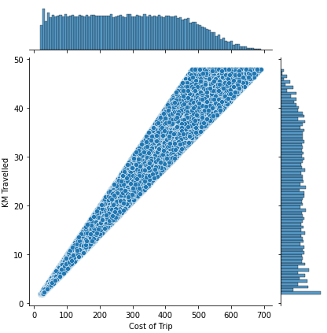
People take longer trips while a small amount of people take shorter ones.

